Slide 1
Ball Bot
M.TayebZadeh
A.Razaghi
M.Farahat
H.Roodabeh

Slide 2
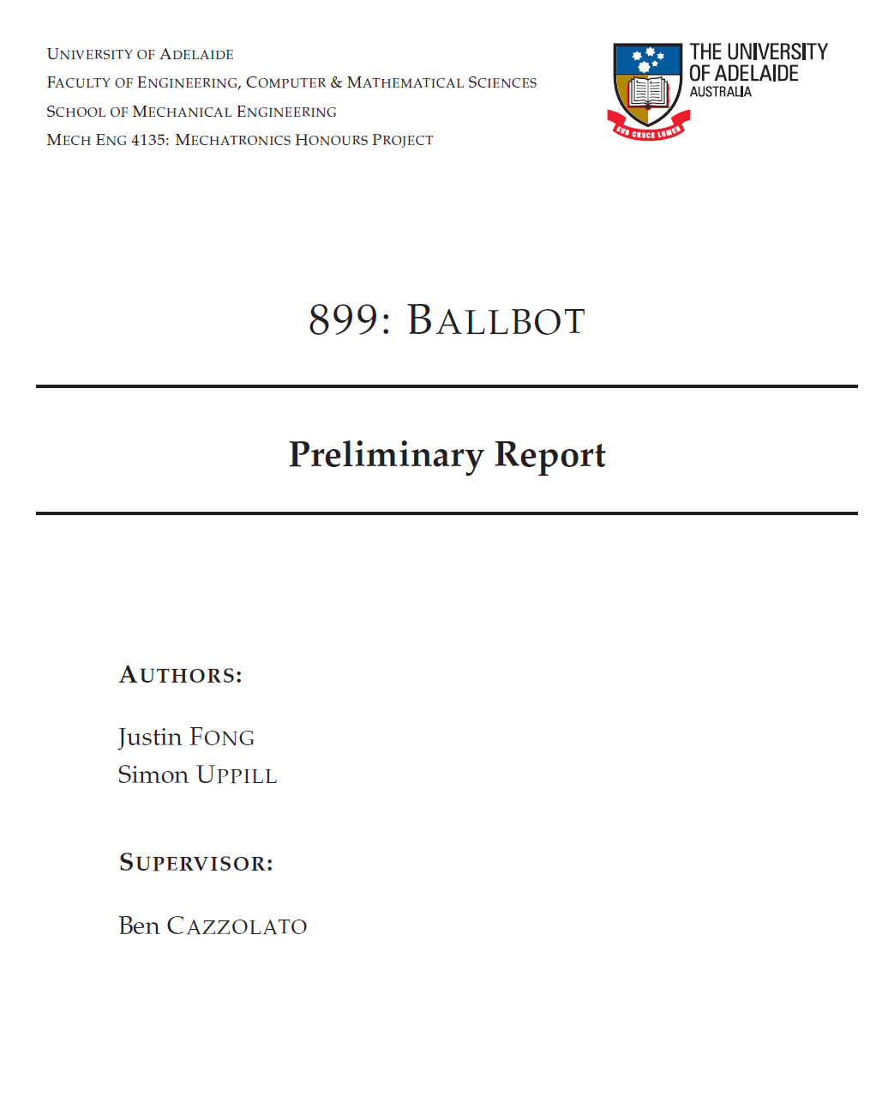
Piece of the Thesis

Slide 3
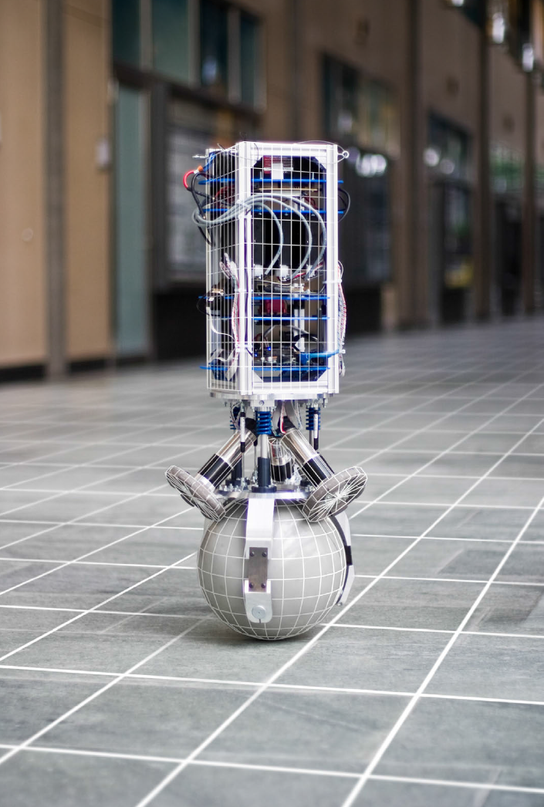

General Concept
Similar to an inverted pendulum
Agility as a core feature

Slide 4
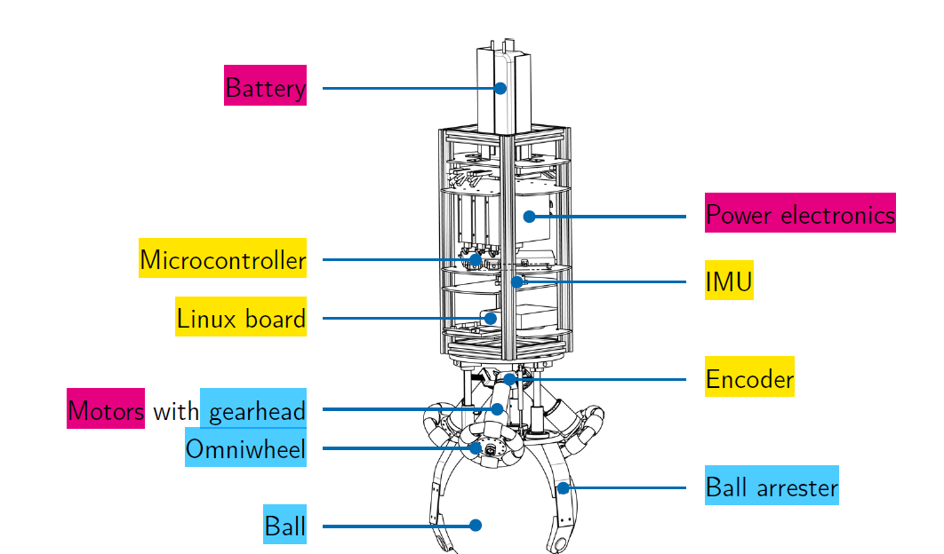
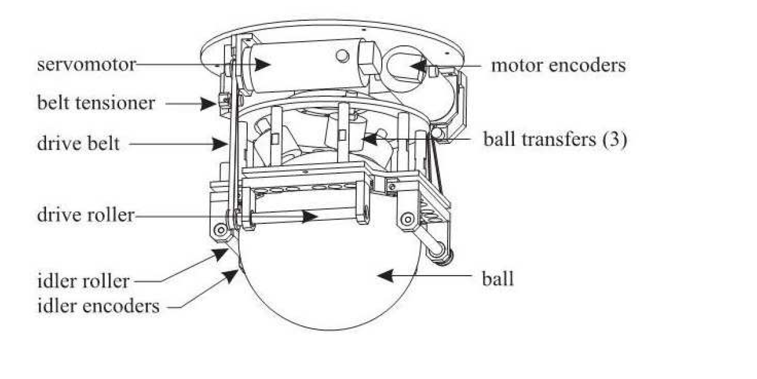
How Does Ball Bot Look like?
The set points are sent to the embedded microcontroller by a Linux board
IMU: Inertial Measurement Unit
Two approaches
Servomotor as actuator
States are measured by the IMU and the motor encoders
First approach
second approach

Slide 5
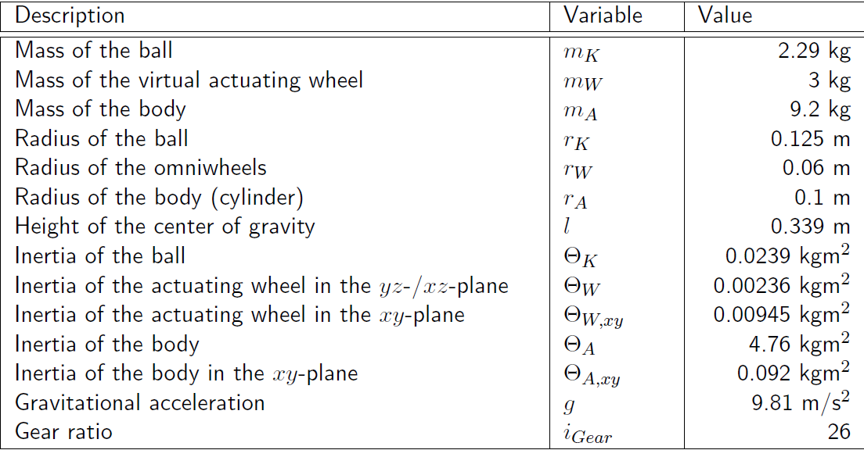
Assumptions
Control Goals
Parameters
Stabilize system
Converge angle between ball and axis to zero or Swing around zero(first variable state )
No slip
No Friction
NO Deformation
Fast Motor Dynamics
S

Slide 6
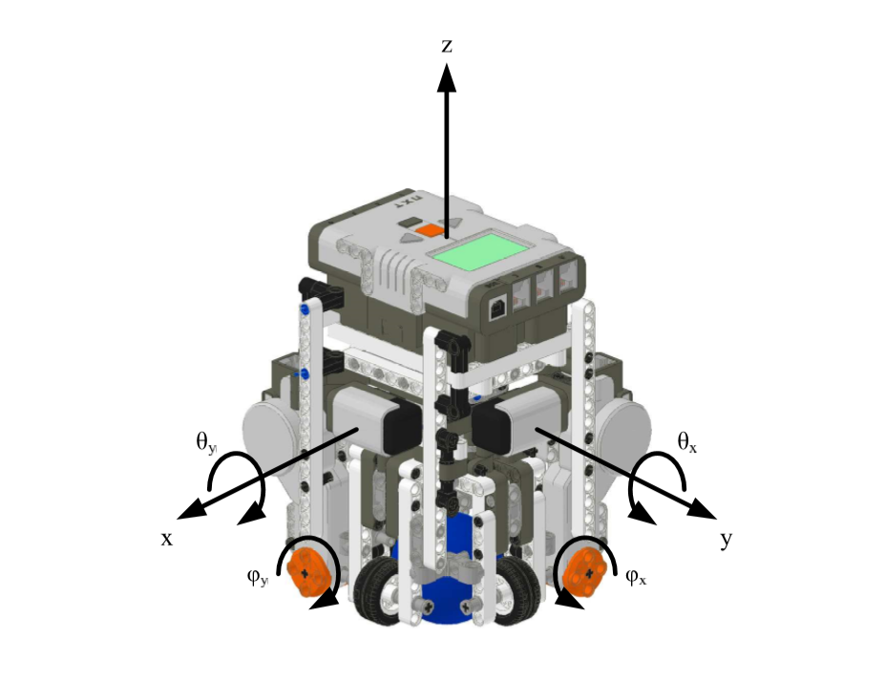
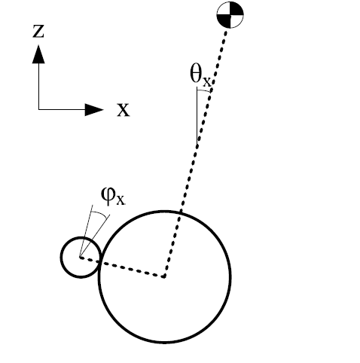
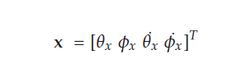
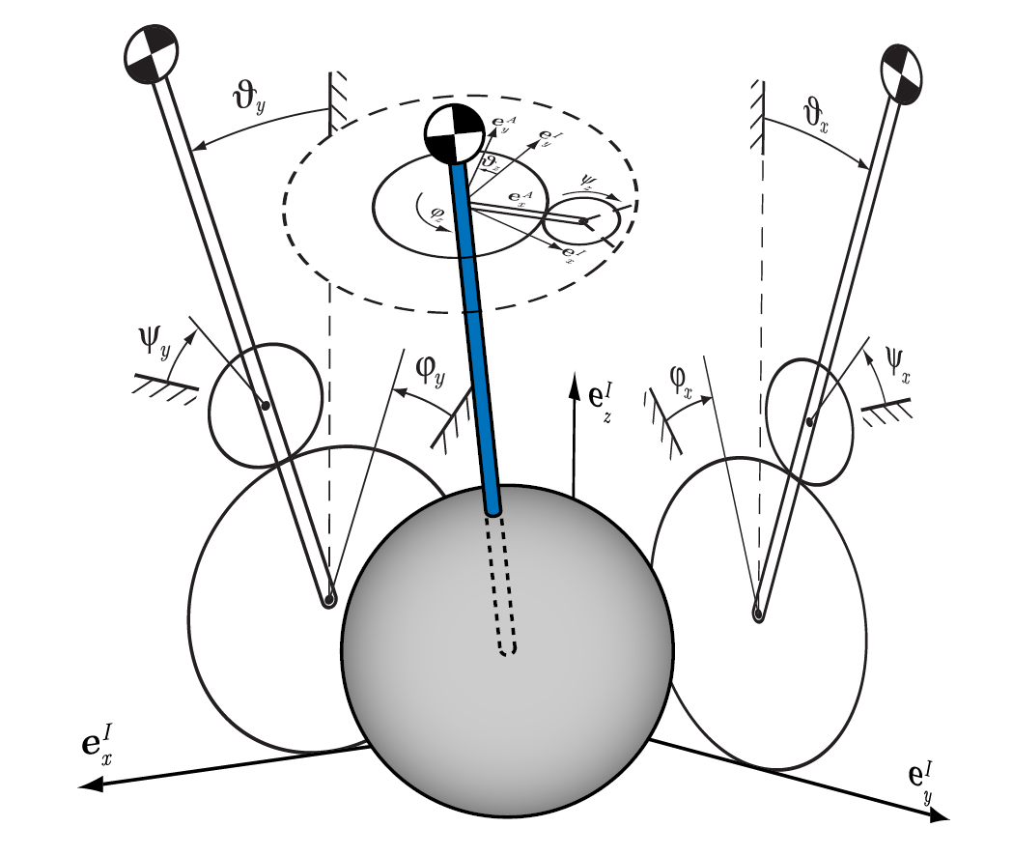

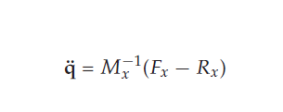
System Model in State Spae
Plane x-z , y-z
State variable
The Euler-Lagrange equations
S

Slide 7
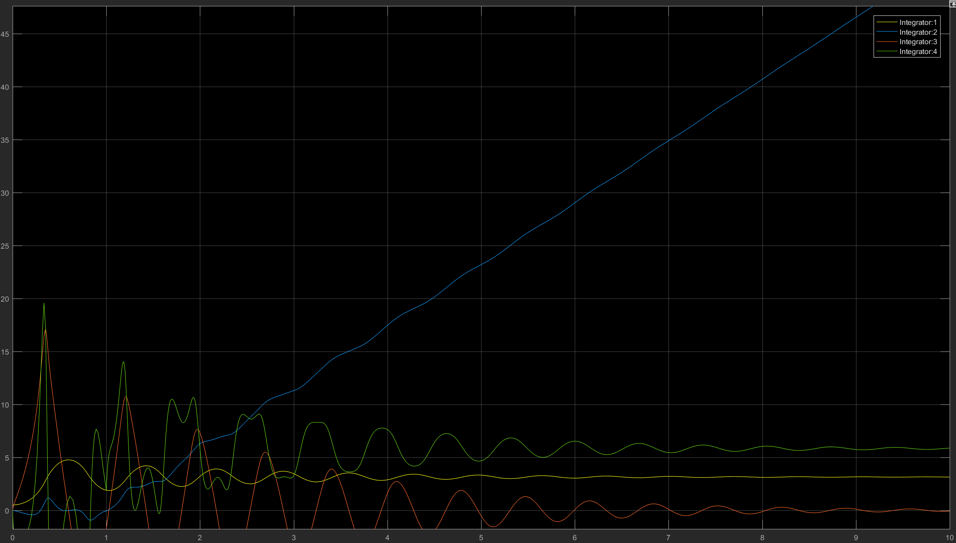
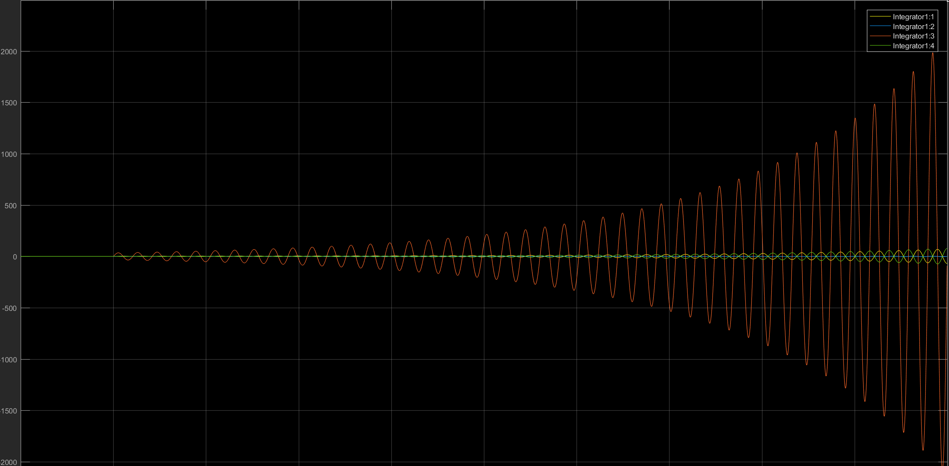
Non-linear
non-linear
Performance of variables
Comparison with linear system
Have some limitation in non-linear system that prevent infinite answer
Analyze open-loop system in steady state
S
linear

Slide 8

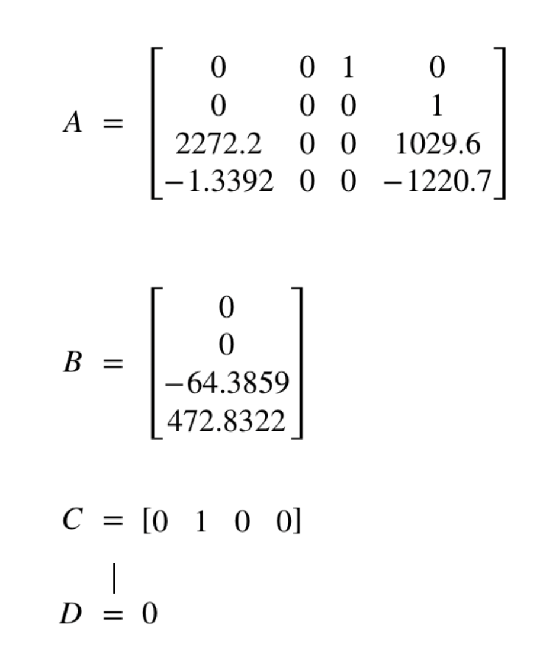
The Area system works

Slide 9
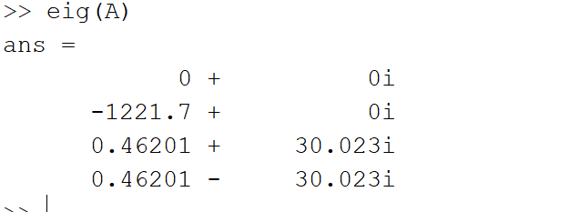
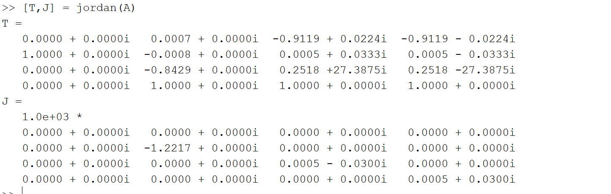
Jordan form
Modes of system
Jordan form
and similarity transfer

Slide 10
no region of attraction
According to the last slides
We have infinite answer in linear model with any initial values
But we have some limitation in non-linear and never have infinite answer
Overally because we have unstable system , region of attraction is an empty space

Slide 11
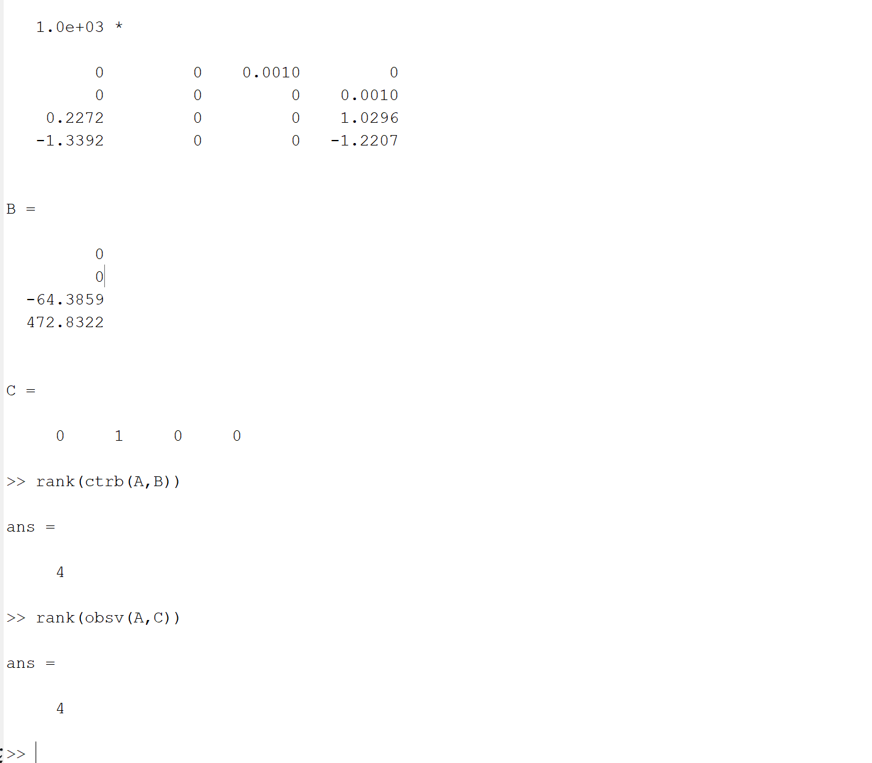
Controlabillity and observability
Our realization is minimal
So we don’t need colman decomposition
So we can control and observe
All the poles even unstable poles

Slide 12
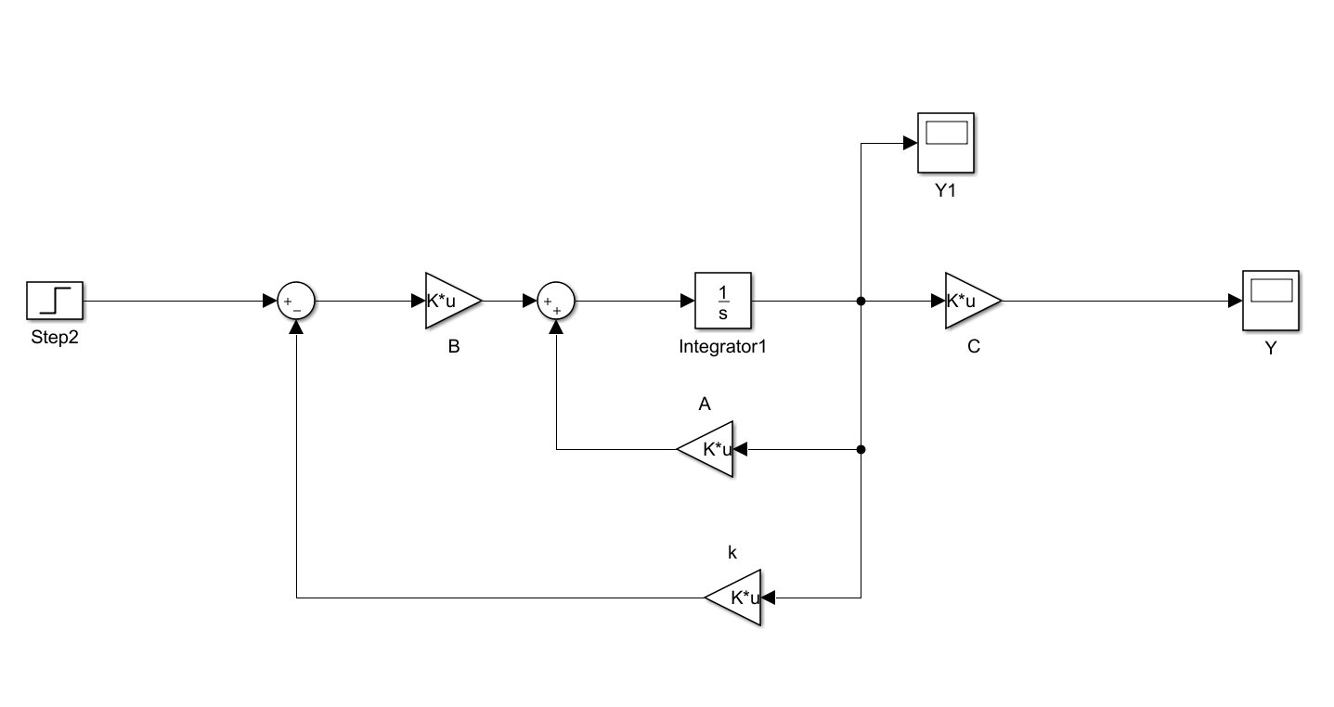
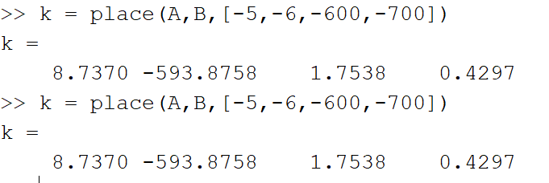
Second part
State Feedback

Slide 13
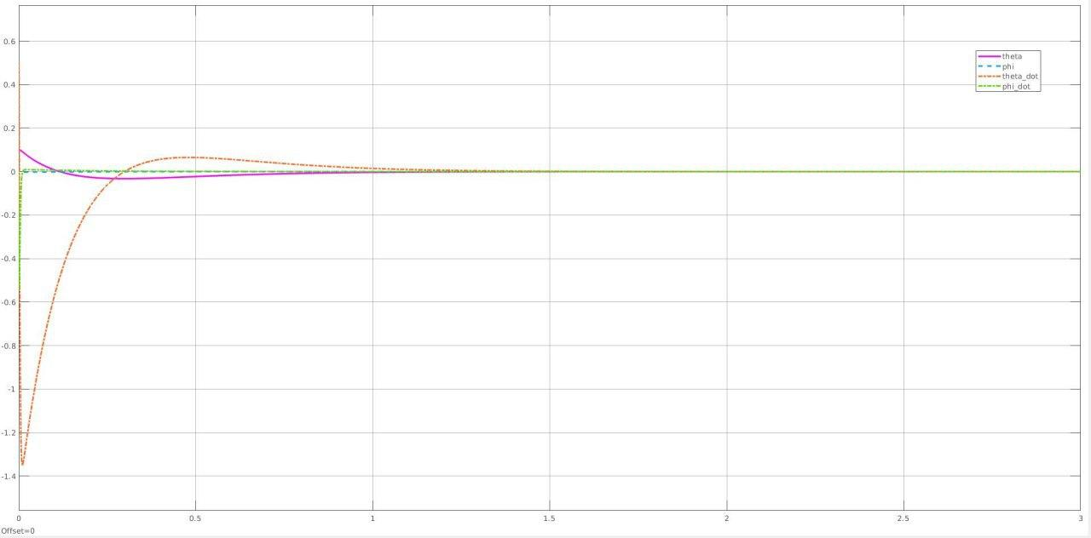
State Feedback

Slide 14
Second part
State Feedback with static gain
Because our reference input is zero
, it’s multiplication with any gain will be zero .
Our plant input is voltage
Output are angles and speeds we defined
We don’t have to follow input .

Slide 15
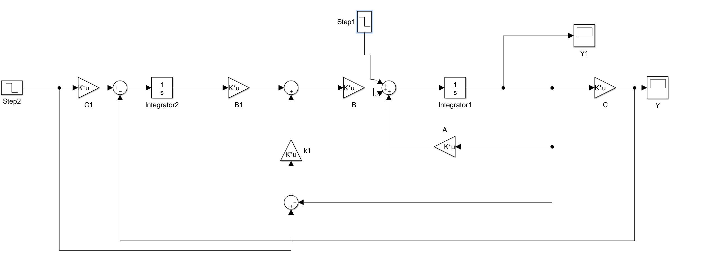
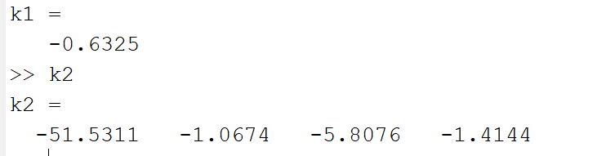
Second part
State feedback with integrator and dynamically

Slide 16
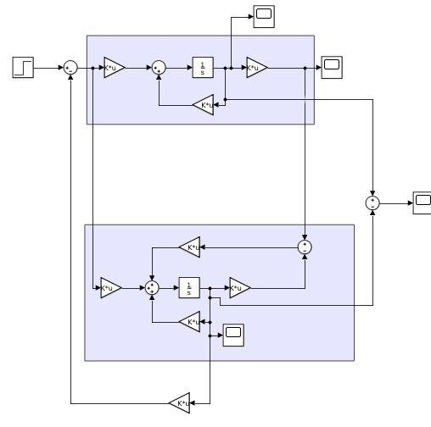
Second part
Complete Observer - linear model

Slide 17
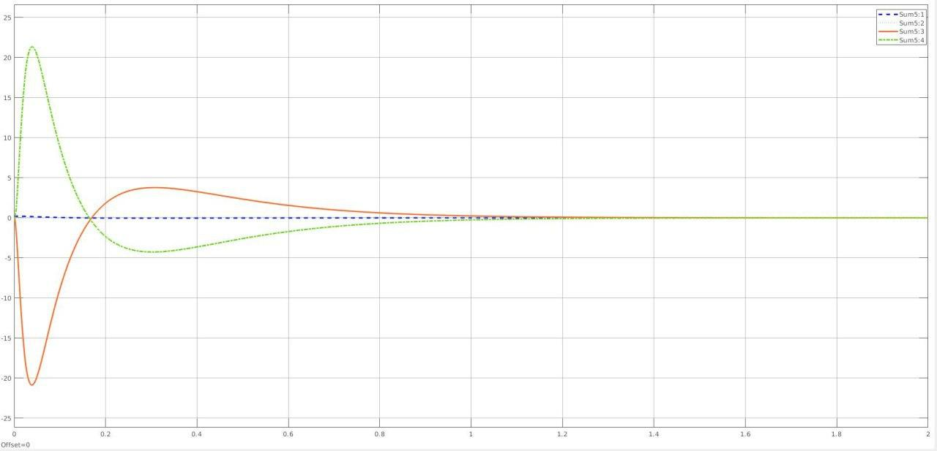
Second part
Complete Observer - linear model

Slide 18
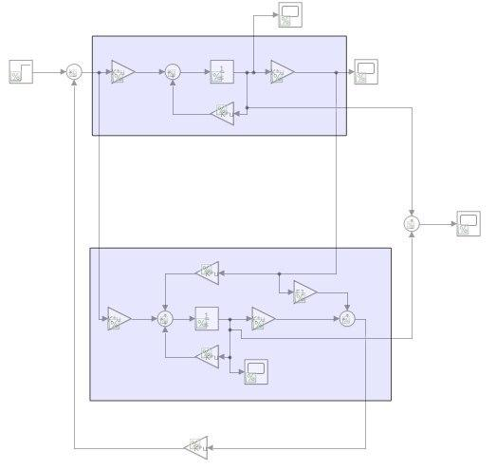
Second part
Reduced Observer - linear model

Slide 19

Third part
Equilibrium points
Lyapanov
(first method of lyapanov was done at last slides . )

Slide 20
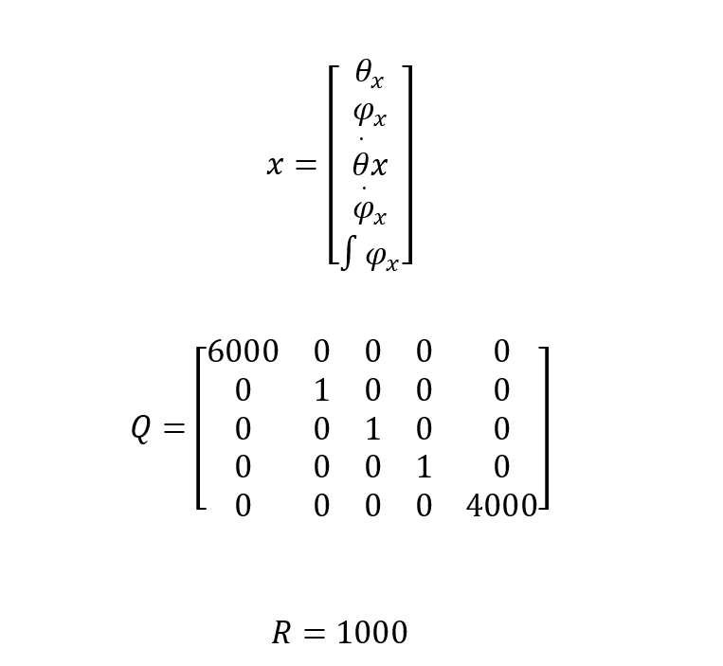
Third part
To omit the error at state variables , we add one extra variable something like state feedback with integrator in a dynamic manner .
LQR

Slide 21
REFERENCES

Slide 22
REFERENCES

Slide 23
Thanks for your attention,
Any questions?

